Slide 1
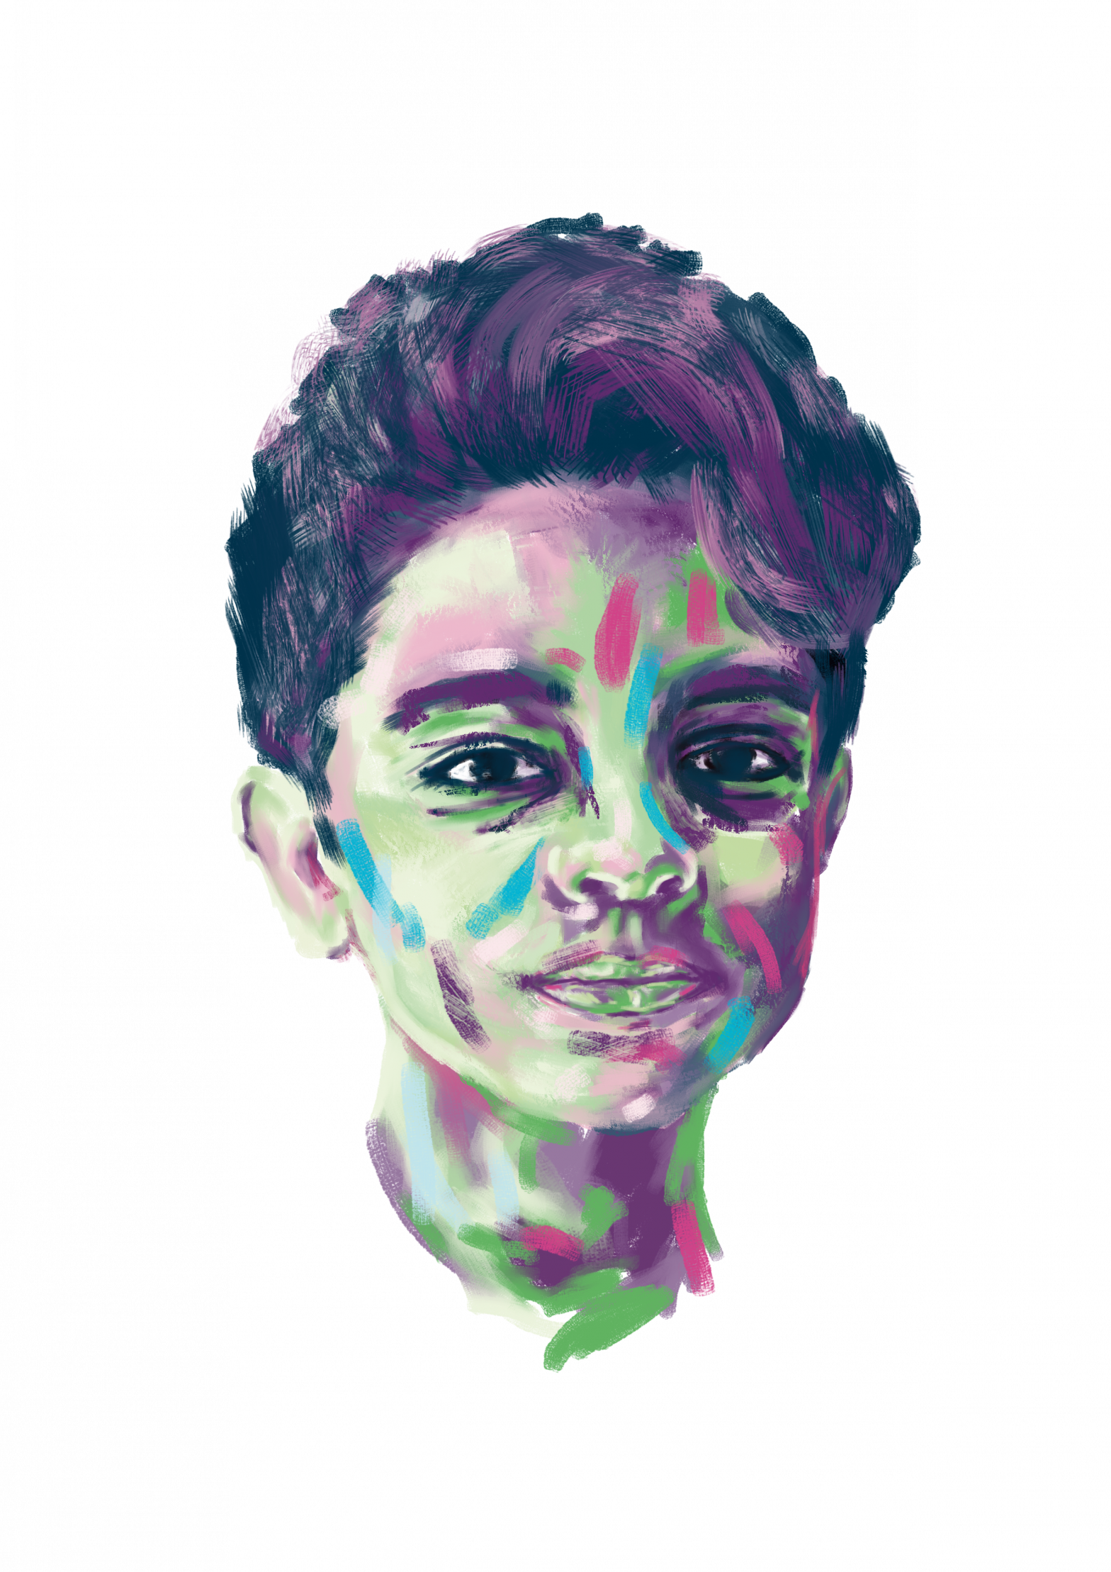
REZA’s Story
Thirteen-year-old Reza lives in Iran with his family. He lives with a rare disease called Cystinosis. Cystinosis affects between 1 in 100,000 and 1 in 200,000 people.
It affects the kidneys and eyes the most. It affects different people in different ways.
Reza’s kidneys have been badly affected, and his treatment has included receiving a kidney transplant. This has affected his ability to socialise with his friends and he isn’t always able to participate at school.
Reza loves going to the cinema and reading books. He also likes singing and dancing and music. He wants to be an actor when he grows up. Reza focuses on the positives in life and is grateful for the treatment and support he has received so far. Each year Reza joins a Cystinosis event which helps him meet other people living with a rare disease. It is a safe place where they can make friends and share their stories.

Slide 2
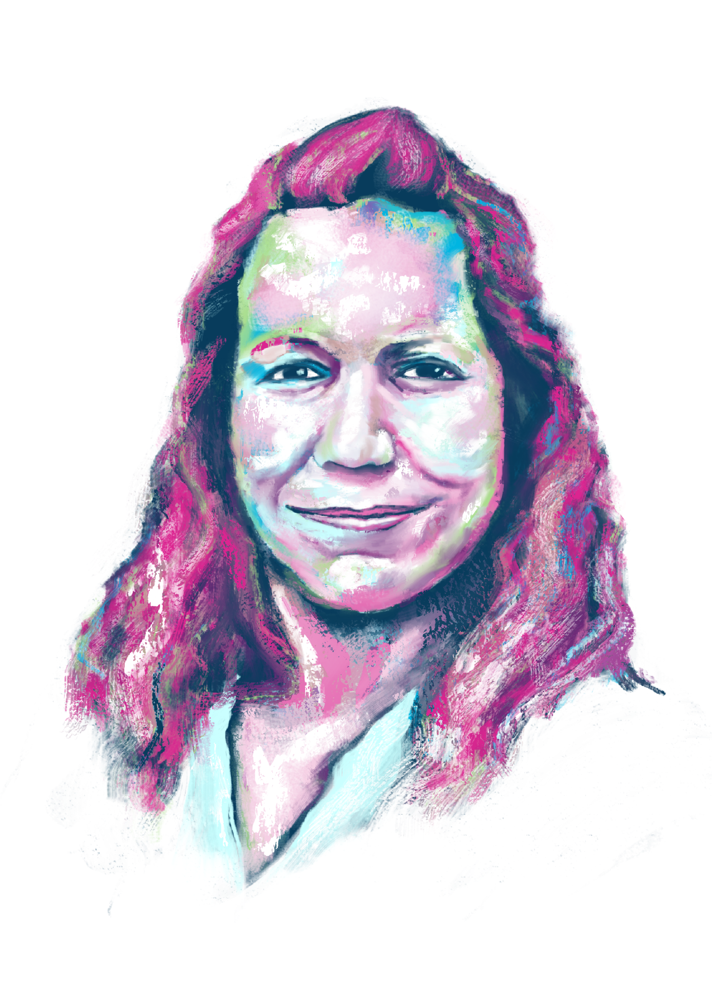
Jelena’s Story
Jelena has Cystic Fibrosis. This rare disease means she finds it difficult to breathe as her lungs do not function properly. She is more likely to get infections too.
Medication to treat cystic fibrosis is limited. Even if a new medicine is developed in one part of the world, the chances of it being available in another are small. Jelena has been unable to benefit from a new kind of treatment that could greatly improve and prolong her life. The medication was developed in the United States, and Jelena can’t access it because she lives in Serbia.
Jelena sometimes finds it difficult to get out of bed due to tiredness. Frequent treatment means taking regular time-off, but her determination not to let the disease get in her way helped her graduate from university with a degree in Economics, Finance and Banking. Jelena likes traveling, walking, and being outdoors with her husband and friends. Jelena supports better treatment of adults with the Cystic Fibrosis, better understanding of the disease and its side effects, increased state funding for basic treatment, and social support for people with Cystic Fibrosis.

Slide 3
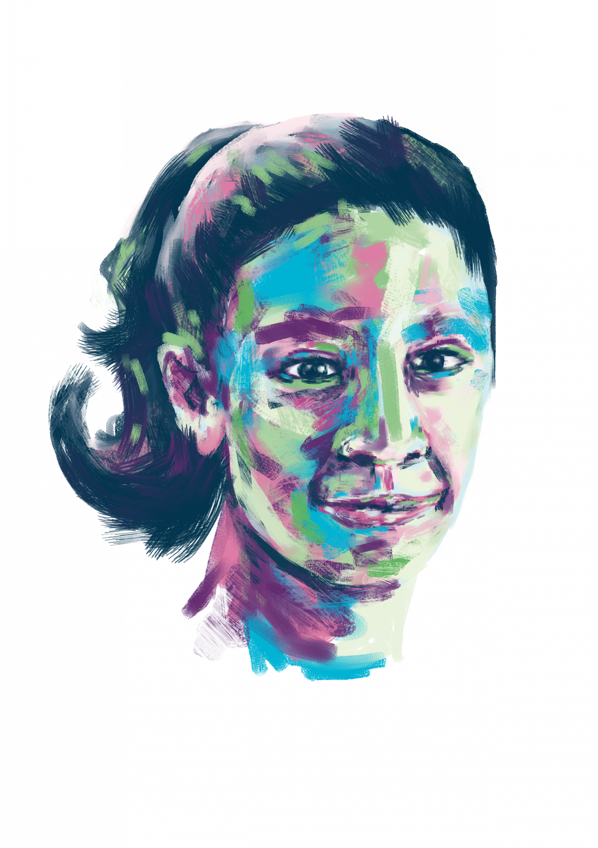
Nitzia’s Story
As a child, Nitzia went to medical appointments for nine years across four different hospitals before she was finally diagnosed with Turner syndrome. Turner syndrome is difficult to diagnose because symptoms vary between patients and sometimes only emerge during puberty. It only affects females and is a genetic disease. Turner syndrome can cause stunted growth and underdeveloped ovaries. Girls and women with Turner syndrome need to go for lifelong checks on their heart, kidneys and reproductive systems, but with the right support it is possible to experience a good quality of life.
Nitzia loves skating, swimming, playing with Barbie dolls, watching Sailor Moon movies and series and other comics. She also enjoys going to the movies, playing with her dog, ​Miztli, or spending time with her family. However, it can be tiring to do lots of things at the same time.
Nitzia now receives regular treatment. Nitzia’s Mum goes with her to her hospital appointments. By connecting with others in the rare disease community, Nitzia and her family receive support from all over the world.

Slide 4
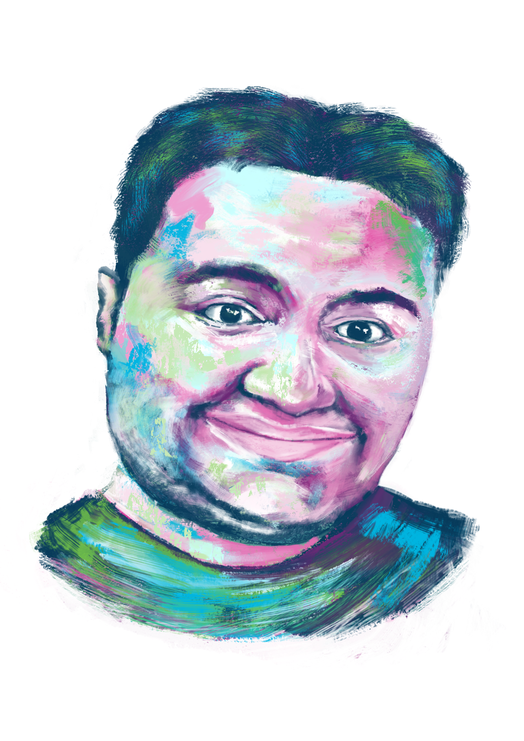
wafic’s Story
When Wafic was just a toddler, he was diagnosed with Duchenne Muscular Dystrophy, a rare and incurable genetic disease. This disease affects people’s muscles from a young age. They get progressively weaker, and this makes it difficult for children to jump, run, and walk.
When Wafic was first diagnosed, his parents felt completely alone. They received no support and no explanation of what Duchenne muscular dystrophy was. Wafic is now 20 years old and feels lucky to receive the medical help and support that he needs. He believes more needs to be done to support patients and families affected by rare diseases.
Wafic is now unable to stand or maintain his balance. Raising his arms has become much more difficult. Wafic needs support for all daily activities like getting up and going to bed. Wafic is passionate about cars and likes to stay up to date about the latest models. He also enjoys going to the cinema and playing video games with his younger brother. Wafic’s parents help spread awareness about the difficulties patients and their families experience from the moment their child is diagnosed with a neuromuscular disease.

Slide 5
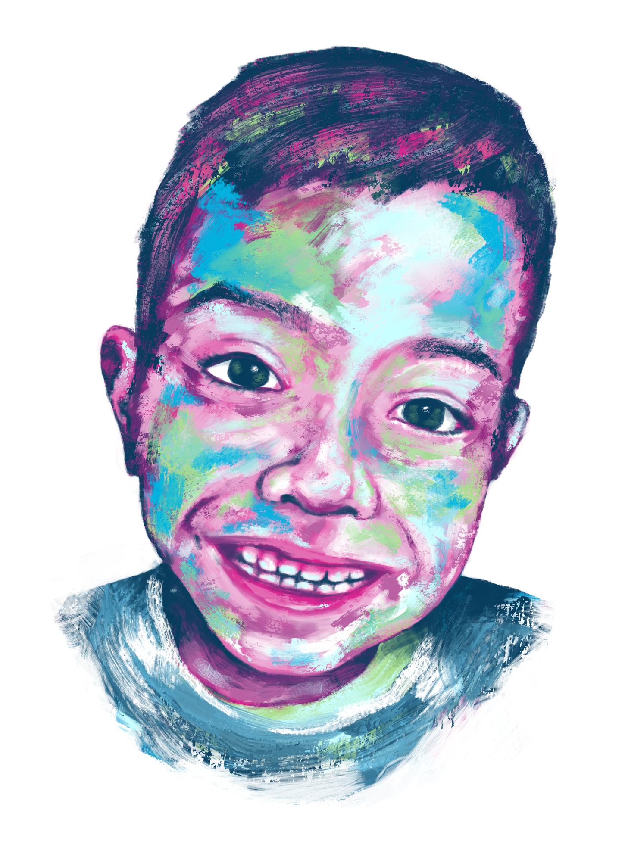
Vasco’s Story
6-year-old Vasco from Peru loves to play, paint, dance and read. But most of all, he loves spending time with his family. It took three years for Vasco to obtain a diagnosis for Gaucher’s disease, a disease that is frequently confused with other illnesses.
Vasco’s symptoms include a lack of red blood cells (anaemia), frequent and persistent bleeding, and growth interference. Treatment for Vasco’s condition is a blood infusion every 2 weeks, for the rest of his life. Sadly, Vasco has been unable to receive this treatment.
Vasco’s mother is fighting for the government to allow him access to this treatment, which would help to stop the progression of the disease. Vasco’s mother has been unable to work whilst she cares for her son. Vasco also finds difficulty with socialising with other children, facing anxiety over his symptom of bleeding, along with the limitations on his activities due to his condition. Vasco is, in the words of his mother, ”loving, intelligent” and a “brave child, with a desire to live” through all he has experienced at such a young age.

Slide 6
WORD BANK
You might want to use these words to help you
SCARED
ANGRY
HARD
DIFFICULT
BRAVE
LONELY
GRATEFUL
ISOLATED
OPTIMISTIC
STRONG
POSITIVE
DETERMINED
FRUSTRATED
SAD
HAPPY
CONCERNED

